Slide 1
RUNGTA COLLEGE OF DENTAL SCIENCES & RESEARCH
TITLE OF THE TOPIC - ISOLATION
DEPARTMENT OF CONSERVATIVE DENTISTRY AND ENDODONTICS

Slide 2
Specific learning Objectives
At the end of this presentation the learner is expected to know ;
Core areas* | Domain ** | Category #
Introduction | Cognitive | Must know
Method | Psychomotor | Must know
Armamentarium | Cognitive | Must know
*Subtopic of importance
** Cognitive, Psychomotor or Affective
# Must know , Nice to know & Desire to know
( Table to be prepared as per the above format )

Slide 3
Content
Introduction
Methods
Direct methods
Indirect methods
Rubber dam
Recent alternatives to rubber dam

Slide 4
Introduction
In dentistry, separation of a tooth or group of teeth from oral tissues and saliva by use of a dental dam, cotton rolls, or other means to improve access, visibility, and control moisture contamination while restorative or operative dental procedures are performed.
MOISTURE CONTROL
RETRACTION
PATIENT SAFETY
IMPROVED QUALITY OF TREATMENT
GOAL OF ISOLATION

Slide 5
Isolation methods
A) Direct methods
1. Cotton rolls and absorbent wafers
2. Evacuator system & saliva ejector
3. Gingival retraction cord
4. Mouth props
5. Rubber dam

Slide 6
B) Indirect methods
1. Comfortable position of the patient and relaxed surrounding
2. Local anaesthesia
3. Drugs : Anti - sialogogues
Anti – anxiety drugs
Muscle relaxants

Slide 7
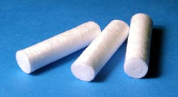
Cotton rolls
Cotton rolls
Placed into areas of mouth where salivary glands ducts exit so that they can absorb saliva
Maxillary teeth – facial vestibule
Mandibular teeth – facial & lingual vestibule
Cotton rolls are not only the moisture absorbents but also aid in minimally retracting the soft tissues from the operating field.
After the procedure , slight moistening of cotton roles is recommended before removing .
This prevent peeling away of epithelium from cheeks , lips causing cotton wool injury .

Slide 8
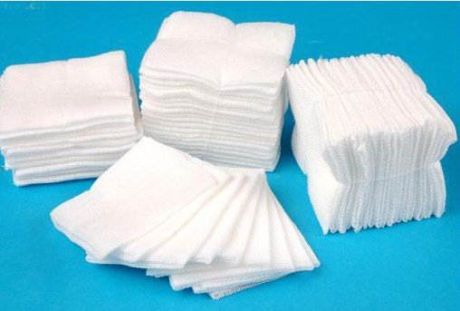
Gauze pieces
Gauze pieces
Gauze pieces may be supplied 2’’x 2’’ or large
They perform the same function as cotton rolls and are generally used for isolation of the larger areas.
Gauze pieces are better tolerated by the delicate tissue
More acceptable
Less chances of adhesion to dry tissues

Slide 9
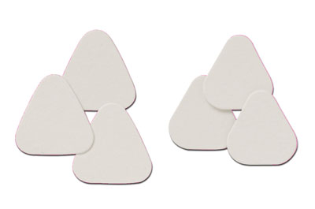
Absorbent pads/wafers
Absorbent pads/ wafers
Absorbent pads are generally made up of cellulose and hence are also called as cellulose wafers
Used inside the cheeks to cover the parotid ducts.
These are more absorbent than the cotton rolls or gauze pieces.

Slide 10
Throat shield
THROAT SHIELD
This is a gauze piece
which is unfolded
spread over tongue & posterior part of mouth
Use:
If there is a danger of aspirating small objects
During placement of indirect restoration

Slide 11
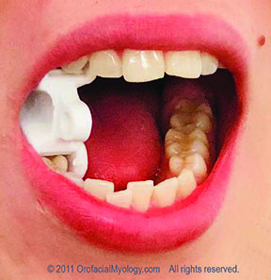
Mouth props
MOUTH PROPS
Adjuncts to restorative treatment in posterior teeth
It maintains mouth opening during various procedures & prevents muscle fatigue in patients
Ideal requirements :
Adaptable to all mouth adjustable when required
Stable once it is applied
Easily removable

Slide 12
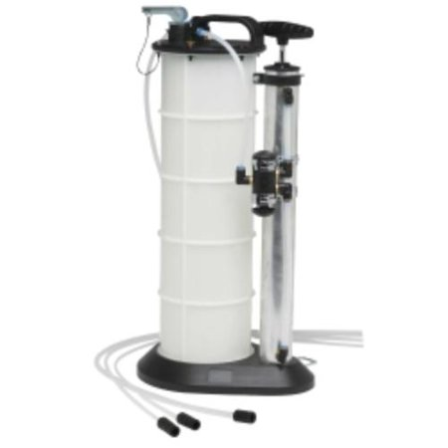
Evacuation system (High volume)
The tip diameter is 10mm and clears 150 ml of water /seconds
Preferred to remove the collected moisture and debris in the mouth because low volume saliva ejectors are slow at work and poor at clearing solids.
The tip usually bevelled and is placed intermittently in the mouth during the operative procedure.
The tip of the evacuator should be placed distal to the tooth being prepared & it should not interfere with the operator’s access .

Slide 13
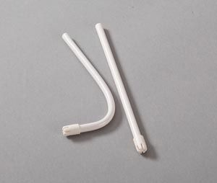
Low volume evacuators
SALIVA EJECTOR
The tip diameter is 4mm and is attached to saliva ejector
Low volume evacuators are basically saliva ejectors which are meant to remove the saliva that collects on the floor of the mouth
They may be shaped by bending with fingers and are most often used along with cotton rolls , cheek pads and rubber dam.
When using it along with the rubber dam, the saliva ejector can be passed through a hole punched in the rubber dam.

Slide 14
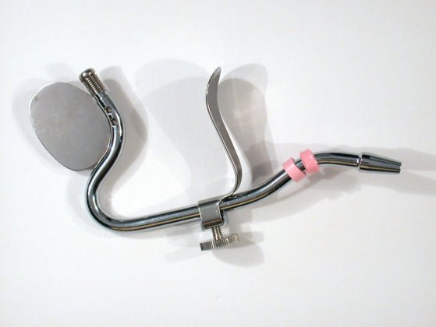
Svedopter (E.C.Moore)
SVEDOPTER
It is a saliva ejector which not only removes saliva but also protects the tongue and floor of the mouth.
A mirror like vertical blade is attached to the evacuator tube so that it holds the tongue away from the field of operation
Several sizes of vertical blades are supplied by the manufacturer
It is designed so that the vacuum evacuator tube passes anterior to the chin and over the incisal edges of mandibular anterior teeth and down to the floor of the mouth
An adjustable horizontal chin blade is attached to the evacuation tube so that it will clamp under the chin to hold the apparatus in place

Slide 15
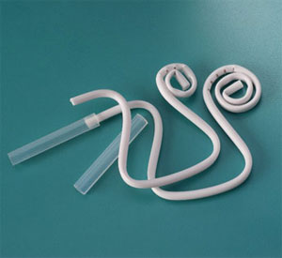
Hygoformic saliva ejector
This coiled saliva ejector is used in the same way as the svedoptor , but it does not have a reflective blade, rather it has a retracting coil
It must be reformed before use
The coil should be loose or partially uncoiled so that it extends posteriorly enough to hold the tongue away from the operating field.

Slide 16
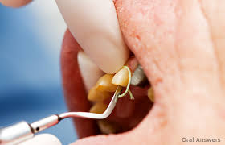
Gingival retraction cord
These are ready made cotton or synthetic fibers woven in the form of cords .
TYPES
plain or impregnated
Available in different sizes
The plain cords may be impregnated with chemicals before their insertion into the sulcus.
These cords are inserted in the gingival sulcus to keep the moisture and gingiva away from the tooth surface for certain procedures like making the impression of a cavity or sub gingival tooth preparations.
It shall not be used for the displacement of gingival tissues when it is swollen or inflamed

Slide 17
Indirect methods
Comfortable and relaxed position of the patient:
The patient should be comfortably seated in the dental chair
Should not be tensed
The surroundings should also be pleasant and relaxing
Comforting attitude of the dental staff reduce the anxiety level of the patient and aids in reducing salivation.

Slide 18
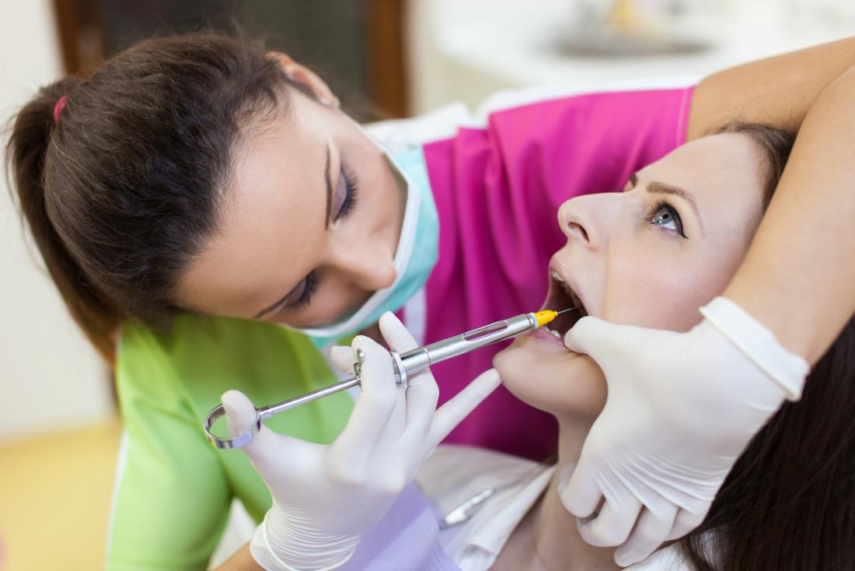
Local anaesthesia
Helps in reducing the discomfort associated with the treatment
ADVANTAGE
vasoconstriction caused by the local anesthesia which help in reducing haemorrhage at the operating site.

Slide 19
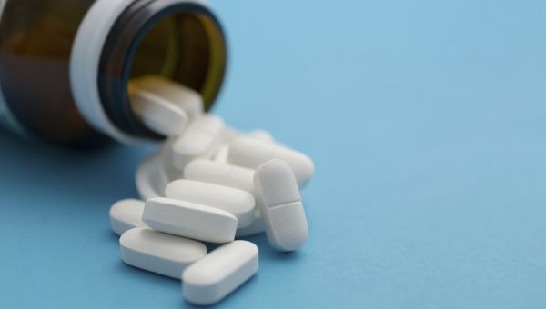
Drugs
Drugs can reduce salivation .
A) Anti-sialogogues
Premedication may be indicated using an anticholinergic agent to depress salivation.
Atropine can be given half an hour before the appointment , but should be avoided in patients with high ocular pressure or with cardiovascular problems.

Slide 20
B) Anti-anxiety agents and barbiturates sedatives:
Premedication with these drugs is quite helpful in apprehensive patients
E.g. diazepam or barbiturates 24 hours before the appointment.
Because of psychological dependence of these drugs should be given only for short period and to selected patients
C) muscle relaxants :
May also be tried

Slide 21
TAKE HOME MESSEGE/ FOR THE TOPIC COVERED (SUMMARY)
In dentistry, separation of a tooth or group of teeth from oral tissues and saliva by use of a dental dam, cotton rolls, or other means to improve access, visibility, and control moisture contamination while restorative or operative dental procedures are performed.

Slide 22
Questions
1) indications of isolation ?
2) what is gingival retraction cord ?
3) what are the direct and indirect methods of isolation ?

Slide 23
references
Endodontics - IngleOperative Dentistry – modern theory and practice - M.A.Marzouk
Art and Science of operative dentistry. Seventh Edition – Sturdevant’s
Clinical operative Dentistry Principles and Practice . Second edition –Ramya Raghu
Author : I . A. Ahmad. Rubber dam usage for endodontic treatment : a review. International Endodontic journal 2009;42:963-972.
Author: Nidambur vasudev ballal, Deepika khandelwal and muliya vidya saraswathi . Rubber dam in endodontics- An overview of recent advances. International Journal of Clinical Dentistry.2018;6(4)320-30.

Slide 24
THANK YOU

